Slide 1

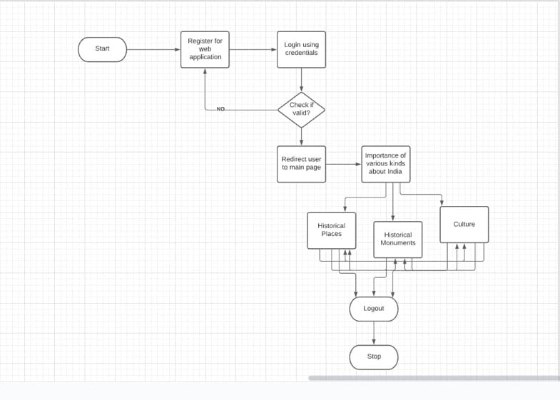
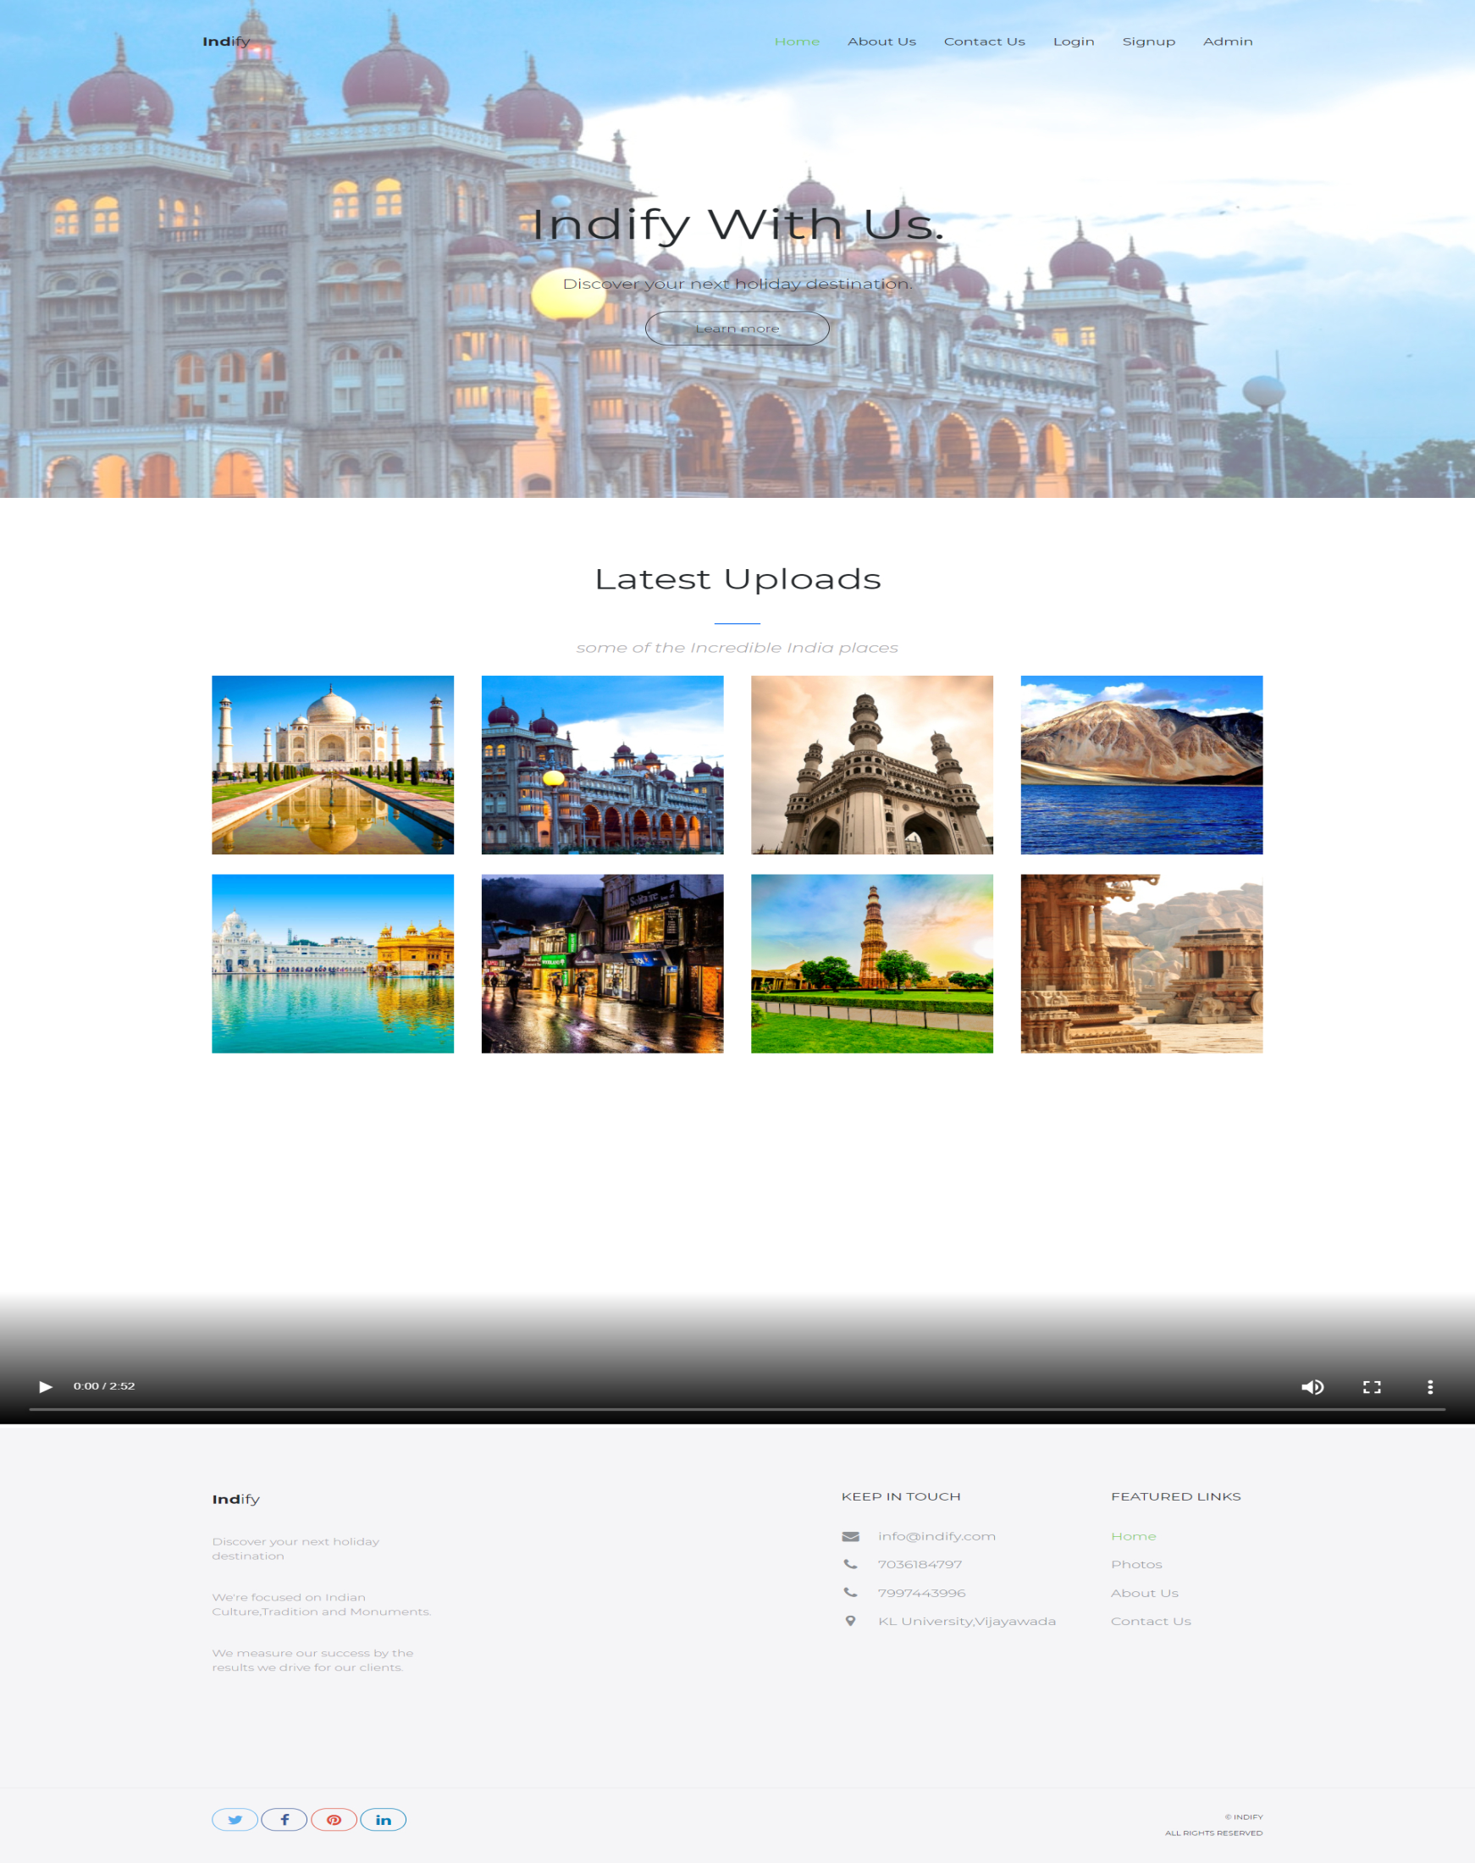
Include Project Title Here
ID-Name of Students separated by comma
Faculty Team Names Separated by comma along with salutations properly
Department of CSE, KLEF
Introduction
Block Diagram
Output Screenshots
Objective
Indian culture is famous across the world due to its diversity in music, art, dance, philosophy, and literature.
This project is to develop a web application to inspire and make people know about the historical Places, monuments and culture of our great India.
Problem Statement
Inspire the people to know the importance of Indian culture and heritage, Historical places and famous monuments
Proposed Solution
Awareness-raising is very powerful because it educates people about to know the real beliefs and encourages them to participate in bringing change in others.
Modules
Conclusion
User Module:
User would be able to see different cultures, dances and food, historical monuments in India.
So our web application helps in creating this type of awareness through the whole of India and also in other countries and Inspires them.
Advantages
Admin module:
Admin adds different monuments, Tourist places and cultures that will be visible to user.
Inspire huge number of people to visit our precious and prestigious Indian monuments and historical places.
It helps in conserving our historical monuments & preserve our indian Heritage
Notes:
Introduction - Objective, Problem Statement, Proposed Solution then Advantages of Proposed Solution [First Column] Block Diagram – System Architecture / Project Flow Modules – Mention modules with their operations [Second Column] Output Screenshots – Use this space to include your project screenshots in such a way that all images must be of same size and properly aligned (You can include images side by side also). You can add one more slide of same size to include more screenshots.

